Slide 1
WHAT IS PSYCHOLOGY?
Psychology is the scientific study of the mind and behavior. It explores how people think, feel, and act, encompassing a wide range of topics including mental processes, emotions, motivations, and social behavior. Psychology uses research and scientific methods to understand these aspects of human experience.

Slide 2
The scientific study of the mind and behavior. It explores thoughts, feelings, and actions, seeking to understand how and why people think, feel, and behave as they do.
Top Right (Characteristics):
Involves research and observation.
Focuses on both normal and abnormal behavior.
Employs various methods, such as experiments, surveys, and case studies.
Aims to understand the biological, social, and environmental factors that influence behavior.
Bottom Left (Examples):
Studying the effects of sleep deprivation on cognitive function.
Analyzing the causes of anxiety disorders.
Developing therapeutic techniques for treating depression.
Investigating the influence of social media on self-esteem.
Exploring the cognitive processes involved in decision-making.
Bottom Right (Non-Examples):
A history textbook. (While history can inform psychology, it is not the same as the study of the mind and behavior).
A medical diagnosis of a physical illness. (Psychology focuses on mental processes, not physical ailments).
A book on astrology. (Astrology is not a scientifically validated field of study).
A philosophical treatise on ethics. (Ethics is related to morality, but psychology focuses on the empirical study of human behavior)
ROOT - The word "psychology" originates from the Greek words "psyche" and "logos". "Psyche" generally refers to the mind, soul, or spirit, while "logos" signifies discourse, study, or reason. Therefore, etymologically, psychology can be understood as the "study of the mind" or "study of the soul". .
Notes:
In ancient Greek, "psyche" encompassed concepts related to life, breath, and the immaterial aspect of a person, often translated as soul, mind, or spirit.

Slide 3
What is COVERED?
Core Topics:
Memory:
This section explores how memory works, including different types of memory (short-term, long-term), encoding, storage, and retrieval processes.
Development:
This area focuses on how humans develop physically, cognitively, and emotionally throughout their lifespan, including childhood, adolescence, and adulthood.
Psychological Problems:
Students learn about various mental health conditions, their symptoms, and potential causes, as well as different approaches to treatment and therapy.
Social Influence:
This section examines how individuals are influenced by others, including conformity, obedience, and group dynamics.
The Brain and Neuropsychology:
This topic explores the structure and function of the brain and how it relates to behavior and cognitive processes.

Slide 4

Where can it take you?

Slide 5

But you won’t learn any of that yet….

Slide 6
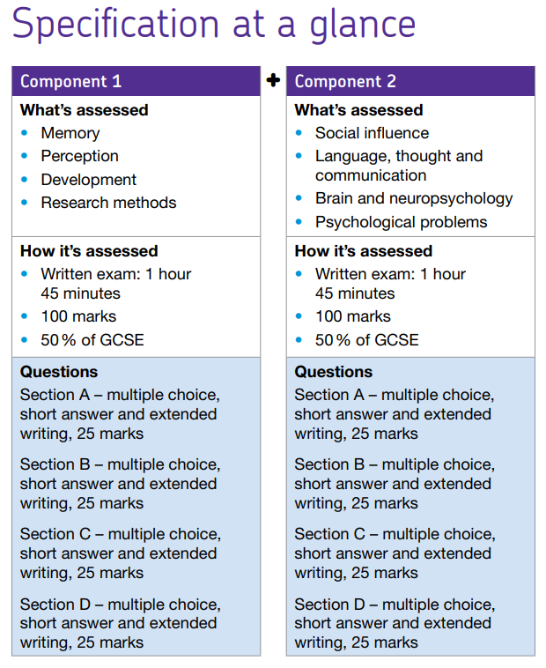
AQA GCSE PSYCHOLOGY

Slide 7
Maths at a high level
Specific examples of mathematical skills in AQA GCSE Psychology:
Percentages:
Calculating the percentage of participants who chose a specific option in a survey, or the percentage of recall errors in a memory experiment. For example, if 15 out of 82 participants scored below average, the percentage is calculated as (15/82) * 100 = 18.29%.
Mean:
Calculating the average score in a memory experiment or the average rating of aggression in an observation study.
Ratios, Fractions, and Percentages:
Using these to analyze data from observations or experiments, such as calculating the proportion of participants exhibiting a particular behavior.
Graphs and Charts:
Constructing and interpreting bar charts, histograms, and scatter diagrams to represent data visually. For example, sketching a scatter diagram to show the correlation between two variables.
Standard Deviation and Range:
Understanding these measures of dispersion to describe the spread of data in a set of scores.
Significant Figures:
Expressing numerical data, like correlation coefficients, to an appropriate number of significant figures.
Probability:
Understanding basic probability concepts to interpret statistical significance levels (e.g., p < 0.05).
Converting Data:
Converting between decimal and standard form, potentially for use in graphs or calculations.
Interpreting Inferential Test Outcomes:
Understanding and using symbols like =, <, >, and the significance levels (e.g., p < 0.05).

Slide 8
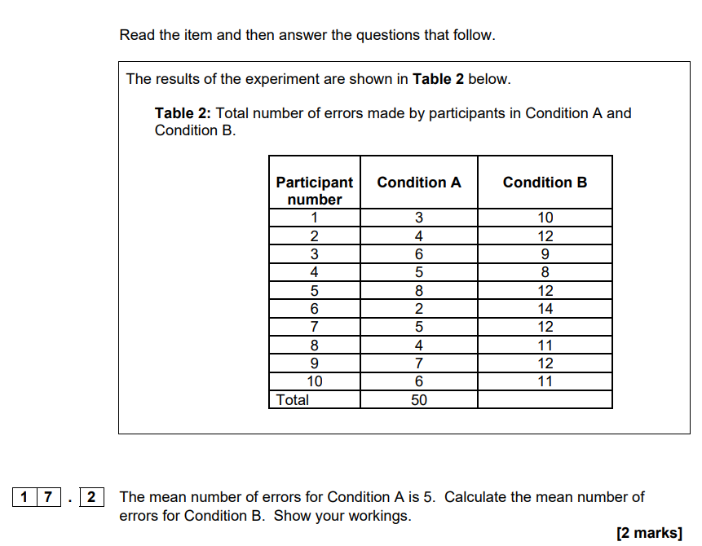

Slide 9
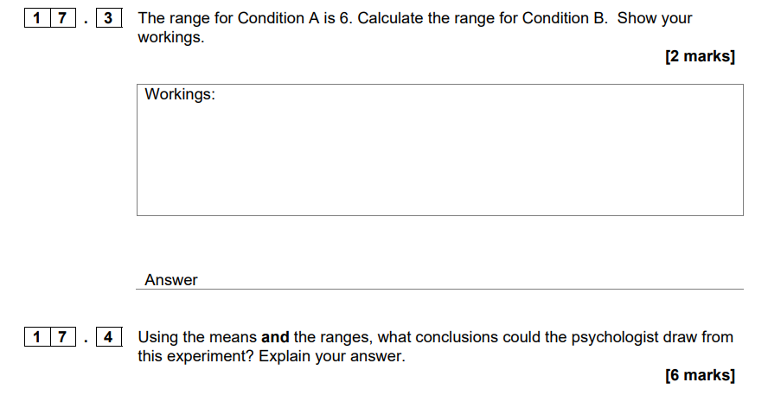

Slide 10
SCIENCE at a high level
AQA GCSE Psychology includes scientific content. You will need to know:
structure and function of the brain,
nervous system,
cognitive functions,
research methods,
cognitive processes like memory and perception.

Slide 11
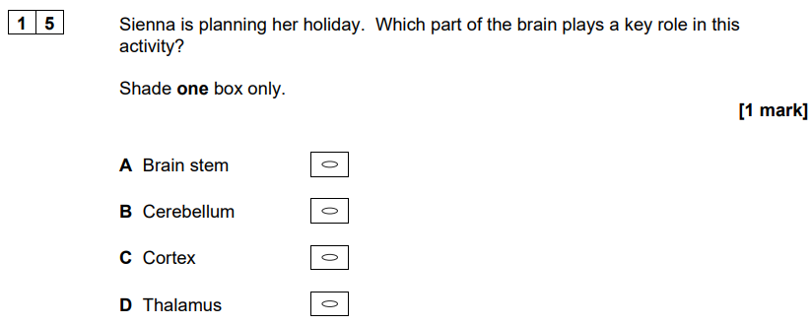
Paper 1 example

Slide 12
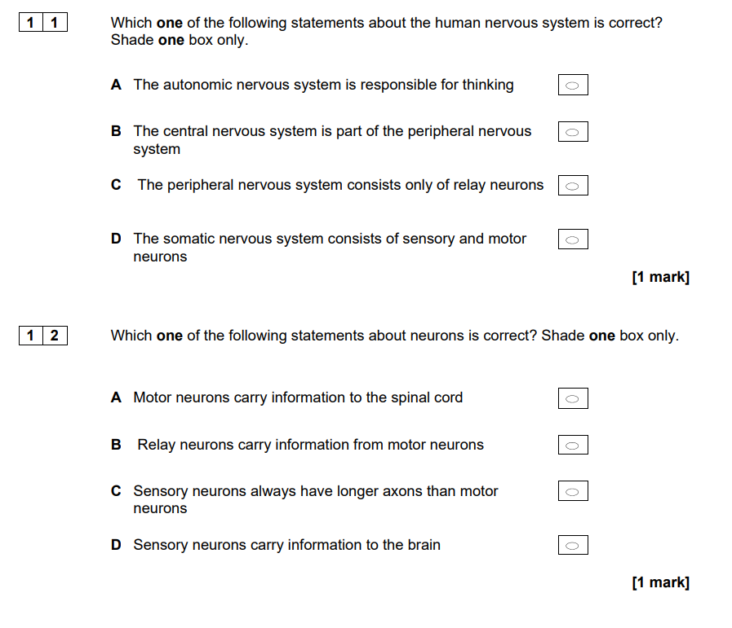
Paper 2 example

Slide 13
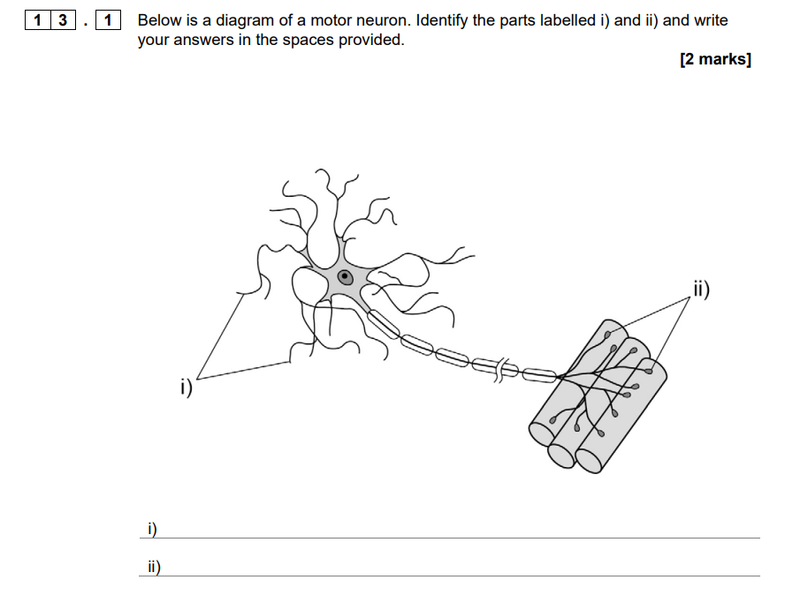
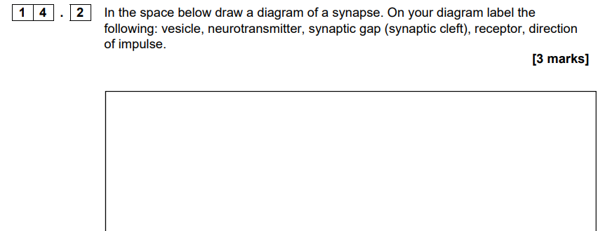

Slide 14
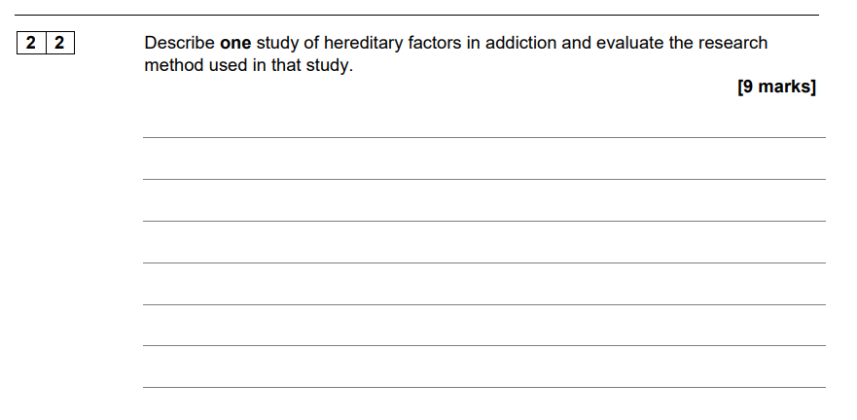
ENGLISH - describe and evaluate is a skill tested in English exams…

Slide 15
Accuracy in Estimate Line Length
In each of the following situations you are given a ‘question’ line Q
You must pick which of the ‘answer’ lines A B or C appears the same length as the question line

Slide 16
Q1
Q
A B C

Slide 17
Q2
Q
A B C

Slide 18
Q3
Q
A B C

Slide 19
Q4
Q
A B C

Slide 20

Social Influence

Slide 21
Social Influence
Asch’s Study of Conformity

Slide 22
Asch’s Study of Conformity
You need to be able to:
Define conformity
Provide an example of conformity
Explain Asch’s study of conformity
Evaluate Asch’s study of conformity

Slide 23
Do you think you’d behave the same as the man in this lift?
Maybe it’s because it’s an old video?

Slide 24

Social influence describes how other people affect our opinions, feelings and even behaviours. Conformity is one form of social influence.
What is meant by the term conformity?

Slide 25

Conformity
Key Term | Definition
Conformity
Conformity is one form of social influence that occurs when an individual thinks or acts similar to those around them.

Slide 26
The individual may be aware that they are conforming or this may be an unconscious process whereby they do not realise that their thinking and behaviour has changed because of others influencing them.
Come up with your own example of conformity.

Slide 27

Asch’s Study of Conformity
You need to be able to:
Define conformity
Provide an example of conformity
Explain Asch’s study of conformity
Evaluate Asch’s study of conformity

Slide 28

Asch (1951)
The Asch conformity experiments were a series of psychological experiments conducted by Solomon Asch during the 1950s. Using a line judgment task, Asch put a naive participant in a room with seven confederates.

Slide 29

Asch (1951)

Slide 30
Asch (1951)
Aim: To investigate if people would conform to the opinions of others and knowingly give an incorrect answer.

Slide 32
